Slide 1
Session – 11 Agile Modelling

Slide 2
Recap for session 10
Elements of the Requirements Model
Types of Elements of the requirements
Scenario-based elements
Class-based elements
Behavioral elements
Flow-oriented elements
Analysis Patterns
Negotiating Requirements
Validating Requirements
Software requirements specification (SRS)
SRS Vs User Stories

Slide 3
Agenda for session 11
Agile Development
An Agile Process
Agile Model - Pros and Cons
The Manifesto for Agile Software Development
Agility Principles – I
Agility Principles – II
Agile Project Management
Agile Testing Methods
When to use the Agile Model?

Slide 4
What is “Agility”?
Agile Development
Effective (rapid and adaptive) response to change
Effective communication among all stakeholders
Drawing the customer onto the team
Organizing a team so that it is in control of the work performed
Yielding …
Rapid, incremental delivery of software

Slide 5
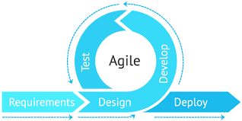
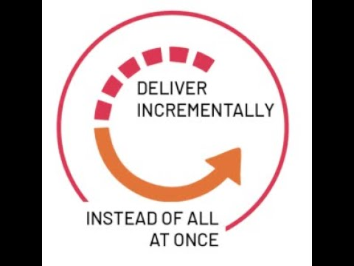
Agile Development (cont…)
Agile SDLC model is a combination of iterative and incremental process models with focus on process adaptability and customer satisfaction by rapid delivery of working software product. Agile Methods break the product into small incremental builds. These builds are provided in iterations.

Slide 6
Agile Development (cont..)
Requirements gathering: In this phase, you must define the requirements. You should explain business opportunities and plan the time and effort needed to build the project. Based on this information, you can evaluate technical and economic feasibility.
Design the requirements: When you have identified the project, work with stakeholders to define requirements. You can use the user flow diagram or the high-level UML diagram to show the work of new features and show how it will apply to your existing system.
Construction/ iteration: When the team defines the requirements, the work begins. Designers and developers start working on their project, which aims to deploy a working product. The product will undergo various stages of improvement, so it includes simple, minimal functionality.

Slide 7
Agile Development (cont..)
4. Testing: In this phase, the Quality Assurance team examines the product's performance and looks for the bug.
Deployment: In this phase, the team issues a product for the user's work environment.
Feedback: After releasing the product, the last step is feedback. In this, the team receives feedback about the product and works through the feedback.

Slide 8
An Agile Process
Is driven by customer descriptions of what is required (scenarios)
Recognizes that plans are short-lived
Develops software iteratively with a heavy emphasis on construction activities
Delivers multiple ‘software increments’
Adapts as changes occur

Slide 9
Agile Model - Pros and Cons
Agile methods are being widely accepted in the software world recently. However, this method may not always be suitable for all products. Here are some pros and cons of the Agile model.
The advantages of the Agile Model are as follows −
Is a very realistic approach to software development.
Promotes teamwork and cross training.
Functionality can be developed rapidly and demonstrated.
Resource requirements are minimum.
Suitable for fixed or changing requirements
Delivers early partial working solutions.
Good model for environments that change steadily.
Minimal rules, documentation easily employed.
Enables concurrent development and delivery within an overall planned context.
Little or no planning required.
Easy to manage.
Gives flexibility to developers.

Slide 10
Agile Model - Pros and Cons
The disadvantages of the Agile Model are as follows −
Not suitable for handling complex dependencies.
More risk of sustainability, maintainability and extensibility.
An overall plan, an agile leader and agile PM practice is a must without which it will not work.
Strict delivery management dictates the scope, functionality to be delivered, and adjustments to meet the deadlines.
Depends heavily on customer interaction, so if customer is not clear, team can be driven in the wrong direction.
There is a very high individual dependency, since there is minimum documentation generated.
Transfer of technology to new team members may be quite challenging due to lack of documentation.

Slide 11
The Manifesto for Agile Software Development
“We are uncovering better ways of developing software by doing it and helping others do it. Through this work we have come to value:
That is, while there is value in the items on the right, we value the items on the left more.”
Following are the Agile Manifesto principles −
Individuals and interactions − In Agile development, self-organization and motivation are important, as are interactions like co-location and pair programming.
Working software − Demo working software is considered the best means of communication with the customers to understand their requirements, instead of just depending on documentation.
Customer collaboration − As the requirements cannot be gathered completely in the beginning of the project due to various factors, continuous customer interaction is very important to get proper product requirements.
Responding to change − Agile Development is focused on quick responses to change and continuous development.

Slide 12
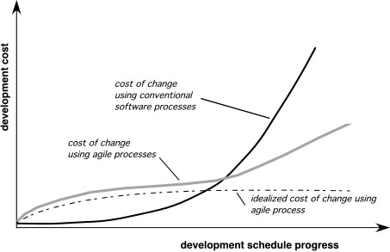
Agility and the Cost of Change

Slide 13
Agility Principles - I
1. Our highest priority is to satisfy the customer through early and continuous delivery of valuable software.
2. Welcome changing requirements, even late in development. Agile processes harness change for the customer's competitive advantage.
3. Deliver working software frequently, from a couple of weeks to a couple of months, with a preference to the shorter timescale.
4. Business people and developers must work together daily throughout the project.
5. Build projects around motivated individuals. Give them the environment and support they need, and trust them to get the job done.
6. The most efficient and effective method of conveying information to and within a development team is face–to–face conversation.

Slide 14
Agility Principles - II
7. Working software is the primary measure of progress.
8. Agile processes promote sustainable development. The sponsors, developers, and users should be able to maintain a constant pace indefinitely.
9. Continuous attention to technical excellence and good design enhances agility.
10. Simplicity – the art of maximizing the amount of work not done – is essential.
11. The best architectures, requirements, and designs emerge from self–organizing teams.
12. At regular intervals, the team reflects on how to become more effective, then tunes and adjusts its behavior accordingly.

Slide 15
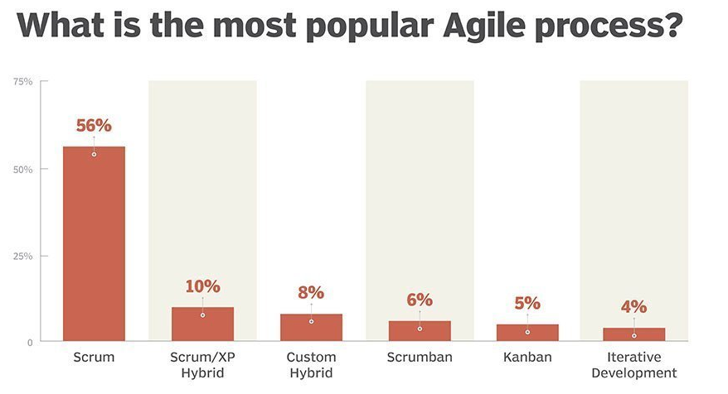
Agile Project Management
Agile Project Management (APM) is an iterative approach to planning and guiding project processes.

Slide 16
Agile Project Management
Jim Highsmith, an Agile Alliance founder and creator of the Adaptive Software Development method, summarizes nine principles for the agile project manager [Highsmith02]:
Deliver something useful to the client; check what they value.
Cultivate committed stakeholders.
Employ a leadership-collaboration style.
Build competent, collaborative teams.
Enable team decision making.
Use short time boxed iterations to quickly deliver features.
Encourage adaptability.
Champion technical excellence.
Focus on delivery activities, not process-compliance activities.

Slide 17
Agile Testing Methods:
Scrum
Crystal
Dynamic Software Development Method(DSDM)
Feature Driven Development(FDD)
Lean Software Development
eXtreme Programming(XP)

Slide 18
Agile Testing Methods (Cont…)
1.Scrum
SCRUM is an agile development process focused primarily on ways to manage tasks in team-based development conditions.
There are three roles in it, and their responsibilities are:
Scrum Master: The scrum can set up the master team, arrange the meeting and remove obstacles for the process
Product owner: The product owner makes the product backlog, prioritizes the delay and is responsible for the distribution of functionality on each repetition.
Scrum Team: The team manages its work and organizes the work to complete the sprint or cycle.

Slide 19
Agile Testing Methods (Cont…)
2. Crystal:
There are three concepts of this method-
Chartering: Multi activities are involved in this phase such as making a development team, performing feasibility analysis, developing plans, etc.
Cyclic delivery: under this, two more cycles consist, these are:
Team updates the release plan.
Integrated product delivers to the users.
Wrap up: According to the user environment, this phase performs deployment, post-deployment.

Slide 20
Agile Testing Methods (Cont…)
3. Dynamic Software Development Method(DSDM):
DSDM is a rapid application development strategy for software development and gives an agile project distribution structure. The essential features of DSDM are that users must be actively connected, and teams have been given the right to make decisions. The techniques used in DSDM are:
Time Boxing
MoSCoW Rules
Prototyping
The DSDM project contains seven stages:
Pre-project
Feasibility Study
Business Study
Functional Model Iteration
Design and build Iteration
Implementation
Post-project

Slide 21
Agile Testing Methods (Cont…)
4. Feature Driven Development(FDD):
This method focuses on "Designing and Building" features. In contrast to other smart methods, FDD describes the small steps of the work that should be obtained separately per function.

Slide 22
Agile Testing Methods (Cont…)
5.Lean Software Development:
Lean software development methodology follows the principle "just in time production." The lean method indicates the increasing speed of software development and reducing costs. Lean development can be summarized in seven phases.
6.eXtreme Programming(XP)
This type of methodology is used when customers are constantly changing demands or requirements, or when they are not sure about the system's performance.

Slide 23
When to use the Agile Model?
When frequent changes are required.
When a highly qualified and experienced team is available.
When a customer is ready to have a meeting with a software team all the time.
When project size is small.

Slide 24
Questions
Define Agility? Explain Agile process.
Explain Classification of methods in agile development.
List out Agile principles.
Illustrate the agile manifesto.
explain agile project management with help of Safe Home application

